Slide 1


Data-Driven Decisions: Order Analytics Dashboard
In business analytics, data-driven decision-making is key. The Order Analytics Dashboard offers a comprehensive view of business performance. It provides insights to enhance profitability and customer engagement.
by Aiyede Sunday

Slide 2

Financial Snapshot: Sales and Profit
$2.3M
Total Sales
$286.4K
Total Profit
10K
Orders Processed
793
Unique Customers
The dashboard shows a healthy business with nearly 10,000 orders. It reaches 793 customers across 49 states and three segments.

Slide 3
Regional Order Distribution
West
East
Central
South
12,000 orders (32.39%)
11,000 orders (28.04%)
9,000 orders (23.18%)
6,000 orders (16.39%)
The West region dominates order volume. Other regions have growth potential.

Slide 4



Order Distribution by Category
Furniture
2
8,000 orders (21.2%)
Office Supplies
1
23,000 orders (60.48%)
3
Technology
7,000 orders (18.32%)
Office Supplies lead, suggesting a business-focused customer base. Furniture and Technology follow.

Slide 5
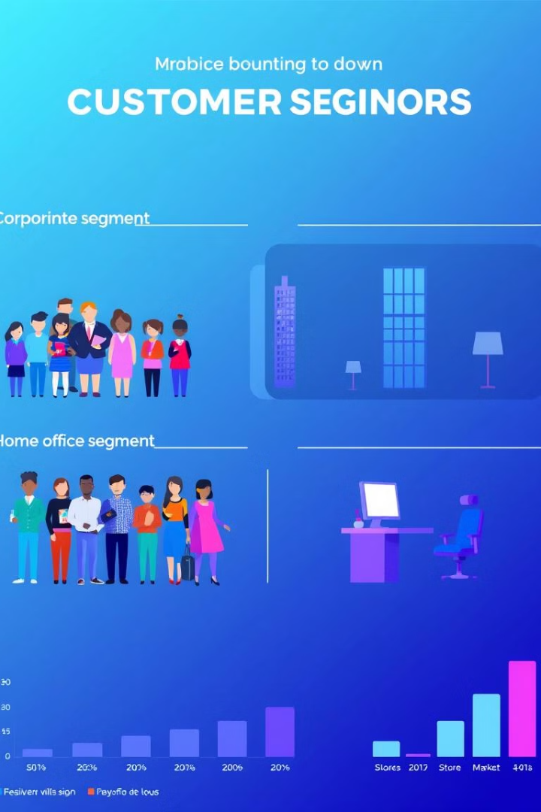
Customer Segmentation
Consumer
Corporate
20,000 orders (51.54%)
12,000 orders (30.65%)
Home Office
7,000 orders (17.81%)
Consumers are the largest segment. The Corporate segment is also substantial.

Slide 6

Top Performing Cities
New York
915 orders
Los Angeles
747 orders
Philadelphia
Significant Contribution
San Francisco
Significant Contribution
New York and Los Angeles are key urban centers driving sales. Other cities include Philadelphia, San Francisco, and Seattle.

Slide 7





Top Customers
Tamara Chand
$9.0K
Raymond Buch
$7.0K
Sanjit Chand
$5.8K
Hunter Lopez
$5.6K
Understanding customer spending can help develop marketing strategies.

Slide 8
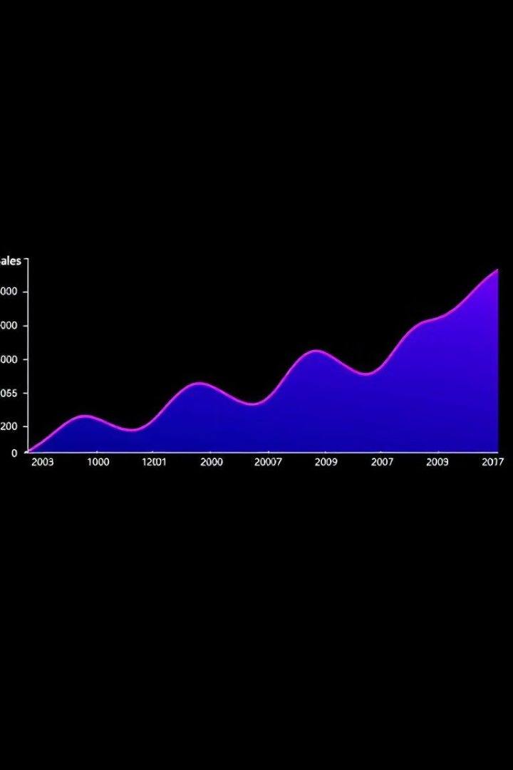
Sales Trends Over Time
1
2014
7.6K orders
2
2015
Orders Increase
3
2016
Orders Increase
4
2017
12.5K orders
Consistent growth with peaks in October and December. Seasonal demand allows businesses to optimize inventory.

